Slide 1
x86 Protected Mode
Marius Vanța
mvanta@bitdefender.com

Slide 2
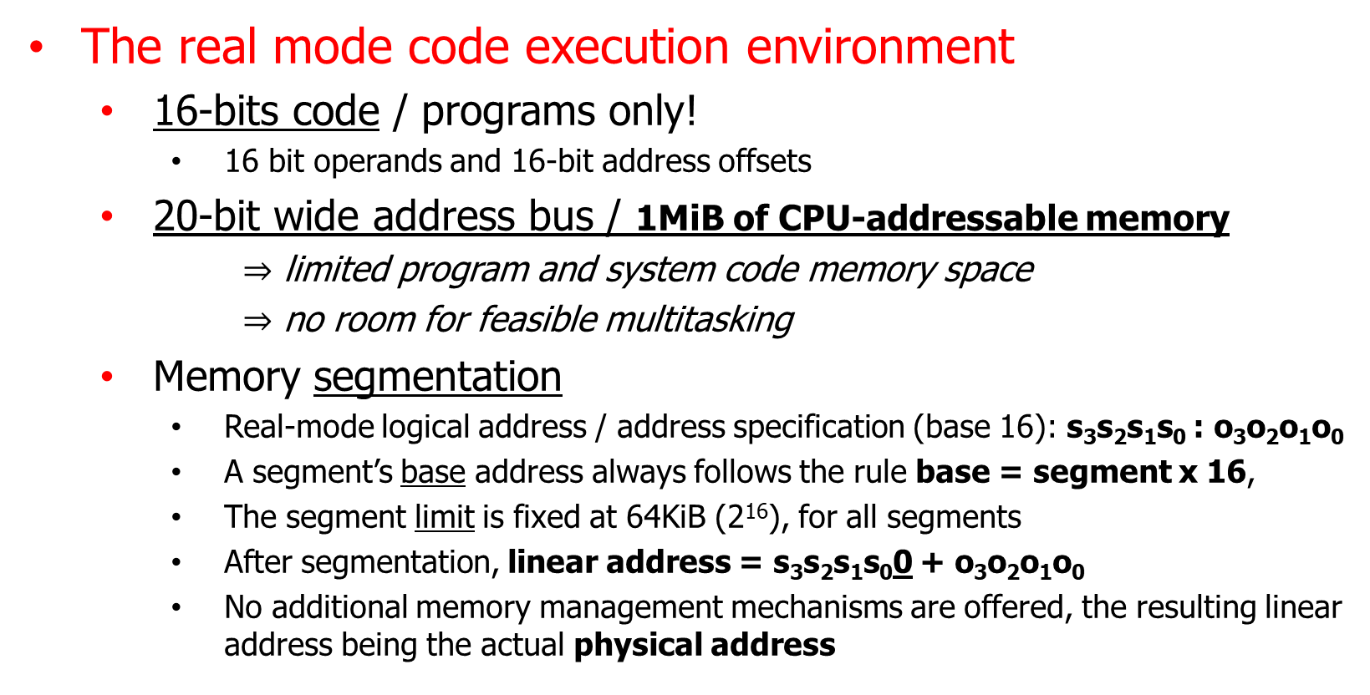
Real-address mode
The real mode code execution environment
  16-bits code / programs only!
    16 bit operands and 16-bit address offsets
  20-bit wide address bus / 1MiB of CPU-addressable memory
      $⇒$ limited program and system code memory space
      $⇒$ no room for feasible multitasking
  Memory segmentation
    Real-mode logical address / address specification (base 16): s₃s₂s₁s₀ : o₃o₂o₁o₀
    A segment’s base address always follows the rule base = segment x 16,
    The segment limit is fixed at 64KiB (2¹⁶), for all segments
    After segmentation, linear address = s₃s₂s₁s₀0 + o₃o₂o₁o₀
    No additional memory management mechanisms are offered, the resulting linear address being the actual physical address

Slide 3
Real-address mode
The real mode code execution environment
  The BIOS and the OS are in no way special, nothing protects them against malicious or unintended alterations by other programs
    Such alterations lead to “undefined behavior” (anything may happen)
  All x86 CPUs are automatically set for real-mode code execution at power-on
    On newer (UEFI) platforms, the firmware initialization code switches the CPU to protected mode automatically
  Transitions between the execution modes
    The real-mode to protected-mode transition can be performed by any program
    Transitions from protected-mode to real-mode are reserved/exclusive to the OS

Slide 4
Real-address mode
Real-mode = unlimited program access, for all programs!
  Any program is allowed to execute any CPU instructions
  The whole memory is shared and accessible to any program
  The external devices are accessible to all programs, uncoordinated
cli ; disable external interrupt/event delivery (EFLAGS.IF <- 0)
hlt ; now halt, don’t execute any more CPU instructions...
mov byte [my_var], 10 ; my_var is 10 now and should keep staying 10
; ...
; how likely is it for my_var to still be 10 at this point and not 42 or 0?
; what if another program (or the time event handler) changed its value?
div byte [my_var] ; a divide-by-zero error can never be excluded!
; an annoying program, “installed” as the timer interrupt (INT 0x1C) handler
; ...
mov al, [last_state]
not al
and al, 111b ; keep the last three bits only
mov [last_state], al
mov dx, 0x60
out dx, byte 0EDh ; tell the keyboard controller that LED state info is coming
out dx, al ; toggle all three LED lights! And do it periodically!
; ...

Slide 5
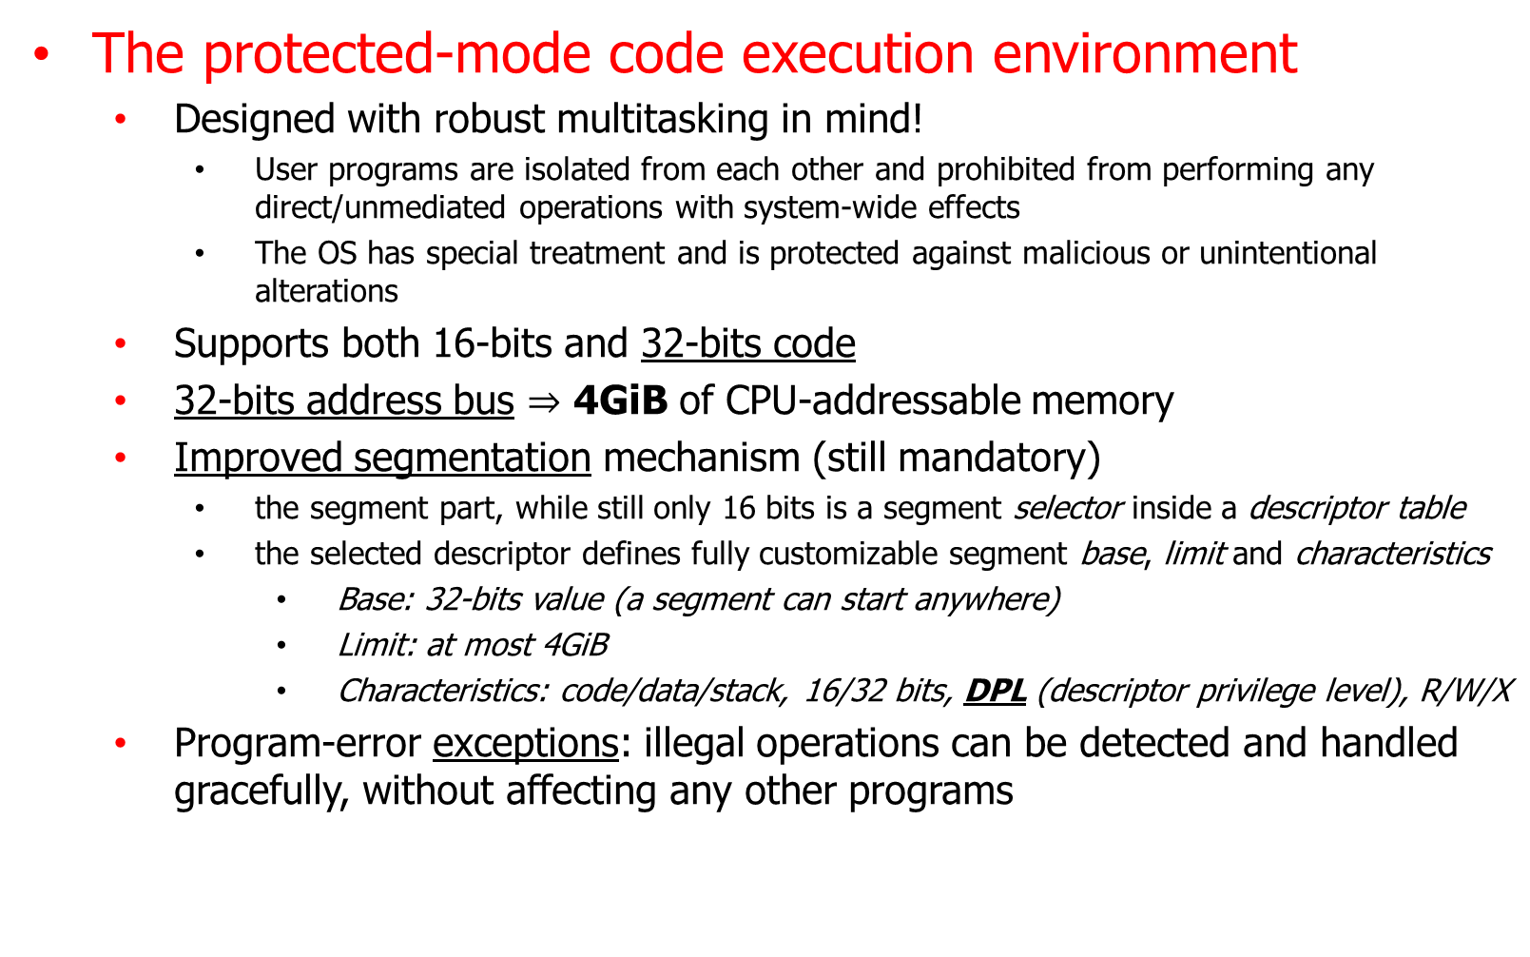
Protected mode
The protected-mode code execution environment
  Designed with robust multitasking in mind!
    User programs are isolated from each other and prohibited from performing any direct/unmediated operations with system-wide effects
    The OS has special treatment and is protected against malicious or unintentional alterations
  Supports both 16-bits and 32-bits code
  32-bits address bus $⇒$ 4GiB of CPU-addressable memory
  Improved segmentation mechanism (still mandatory)
    the segment part, while still only 16 bits is a segment selector inside a descriptor table
    the selected descriptor defines fully customizable segment base, limit and characteristics
      Base: 32-bits value (a segment can start anywhere)
      Limit: at most 4GiB
      Characteristics: code/data/stack, 16/32 bits, DPL (descriptor privilege level), R/W/X
  Program-error exceptions: illegal operations can be detected and handled gracefully, without affecting any other programs

Slide 6
Protected mode
Privilege levels
  4 privilege levels (“rings”): not all code is made equal!
    The CPU is always aware at what privilege level the current instruction is to be executed
      CPL (Current Privilege Level) is derived from the DPL of the current code segment
    Level/ring 0 is used for running the OS kernel (unrestricted code)
    Ring 1 and 2, supposed to allow isolation of the OS kernel from the device drivers, are usually left used
    Ring 3 allows limiting programs from executing any instructions with system-wide effects
; in a user-mode code, the very first instruction will stop the program
cli ; disable external interrupt/event delivery (EFLAGS.IF <- 0)
hlt ; now halt, don’t execute any more CPU instructions...

Slide 7
Protected mode
The interaction between user programs and the OS kernel
  CPL and DPL are at the basis of the provided validations and protections
  More privileged code can always access same or lower privileged data segments
    Less privileged code can never access more privileged data segments
  Switching to a code segment at the same privilege level is always allowed
  Switching to a different privilege-level code segment is only possible when the switch is made to a OS predefined procedure offset within the targeted segment.
    Such procedures are designed to perform thorough parameter and environmental validations
    These procedures / entry points are explicitly defined by the OS through a set of dedicated registers and/or as special IDT/GDT descriptors called gates
    Interrupt and exception handling require privilege transitions between the CPL of the current code segment to the (DPL=0) code segment of the kernel code procedure registered in the IDT
    Note: there can be special code segment that can be loaded into CS without changing the CPL! Such a segment contains procedures that were made available by the OS to more than one ring.
  Stack segments are treaded like the data segments with one notable exception: the architecture allows predefining a default stack segment for each ring, segments that are loaded automatically (by the CPU) into SS when transitions between rings occur
    This way, a known (&good) stack is guaranteed after a transition and the stacks of the code running at various privilege levels can be properly isolated

Slide 8
Protected mode
The interaction between user programs and the OS kernel
ASM program
Std. C library
Less privileged
Ring 3
System libraries
Ring 2 (unused)
OS kernel
Ring 1 (unused)
system exit
More privileged
Ring 0
system call
call [WriteFile]
Privilege (CPL) change
call [fwrite]
No privilege (CPL) change

Slide 9
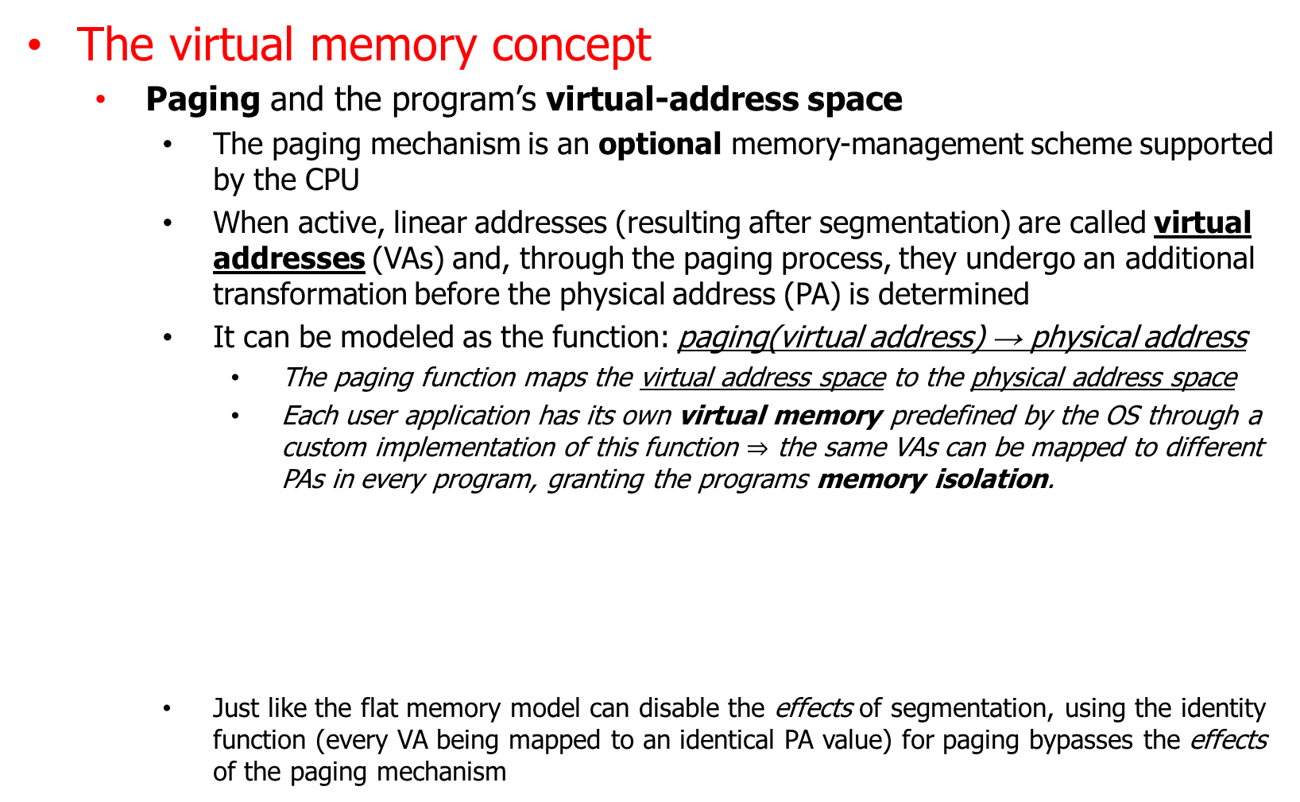
Protected mode
The virtual memory concept
  Paging and the program’s virtual-address space
    The paging mechanism is an optional memory-management scheme supported by the CPU
    When active, linear addresses (resulting after segmentation) are called virtual addresses (VAs) and, through the paging process, they undergo an additional transformation before the physical address (PA) is determined
    It can be modeled as the function: paging(virtual address) → physical address
      The paging function maps the virtual address space to the physical address space
      Each user application has its own virtual memory predefined by the OS through a custom implementation of this function $⇒$ the same VAs can be mapped to different PAs in every program, granting the programs memory isolation.
    Just like the flat memory model can disable the effects of segmentation, using the identity function (every VA being mapped to an identical PA value) for paging bypasses the effects of the paging mechanism
calc.exe
notepad.exe
mov [0x1000], eax
mov [0x1000], eax
Physical memory

Slide 10
Protected mode
The virtual memory concept
  Paging and the program’s virtual-address space
    The actual associations (between VAs and their corresponding PAs) performed by the paging mechanism is defined by the system software through x86 architecturally-defined data structures named hierarchical paging structures
      If we were to consider defining the mappings on a byte-by-byte basis, the volume of necessary data would be impractically large! For this reason, a coarser granularity known as a page size is used and the smallest block of continuous memory individually configurable through paging is called a memory page.
        A pair of VA and PA associated through the paging mechanism are always of the same size and both start at an address that’s a multiple of (are aligned to) page size
    Some technical details regarding the paging structures and how they function
      There are multiple paging modes with different features and (slightly) different data structures!
      The actual paging structures are composed of a hierarchy of page tables structured as a multiway tree with a depth of N (between 1 and 4).
      Every page table is 4KiB in size and has 512 or 1024 entries (QWORDs or DWORDs)
      The highest bits of an input VA are split into N components that are used as indices inside the page tables for traversing the tree.
      The final entries in the leaf-nodes / tables do not link to yet another page table but instead to the actual physical page associated with the entire input virtual page
      The lowest address bits (that were not used as indices) are used as an offset inside the page
      The table entries encode both the address translation and access restrictions too!

Slide 11
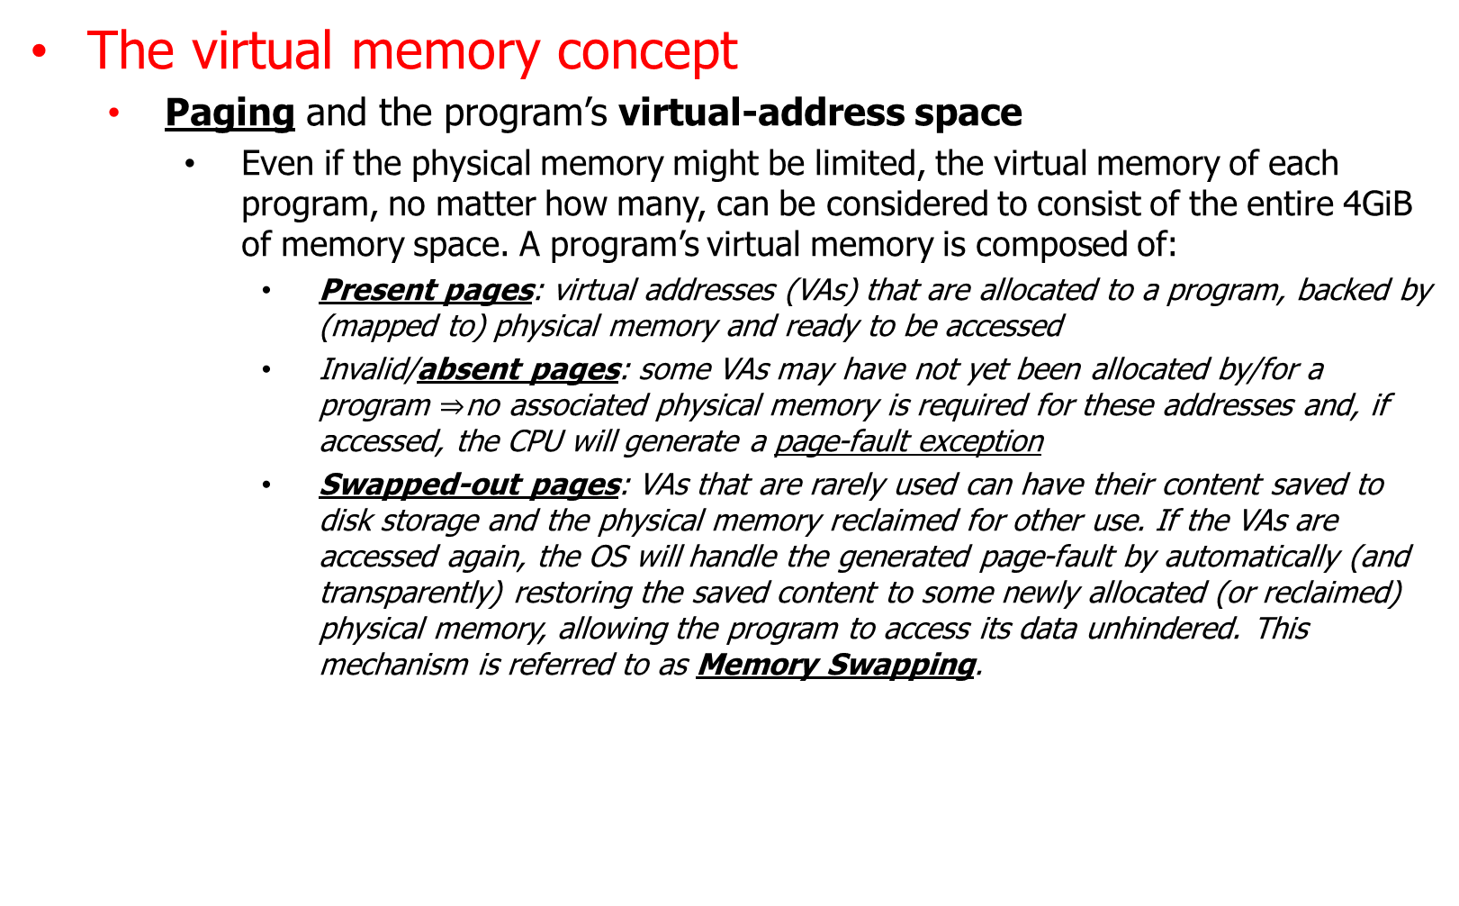
Protected mode
The virtual memory concept
  Paging and the program’s virtual-address space
    Even if the physical memory might be limited, the virtual memory of each program, no matter how many, can be considered to consist of the entire 4GiB of memory space. A program’s virtual memory is composed of:
      Present pages: virtual addresses (VAs) that are allocated to a program, backed by (mapped to) physical memory and ready to be accessed
      Invalid/absent pages: some VAs may have not yet been allocated by/for a program $⇒$no associated physical memory is required for these addresses and, if accessed, the CPU will generate a page-fault exception
      Swapped-out pages: VAs that are rarely used can have their content saved to disk storage and the physical memory reclaimed for other use. If the VAs are accessed again, the OS will handle the generated page-fault by automatically (and transparently) restoring the saved content to some newly allocated (or reclaimed) physical memory, allowing the program to access its data unhindered. This mechanism is referred to as Memory Swapping.
mov EAX, [0x1000] | effect
Present VA(=0x1000) | EAX = data found in the associated physical memory
Absent VA | Page-fault exception (and the program is stopped)
Swapped-out VA | EAX = data found in the associated physical memory

Slide 12
Protected mode
Overview of the segmentation process
Segment Selector
Offset
segmentation
Physical Address

Slide 13
Protected mode
Overview of the segmentation & paging process
Segment Selector
Offset
segmentation
Virtual Address
paging
Physical Address

Slide 14
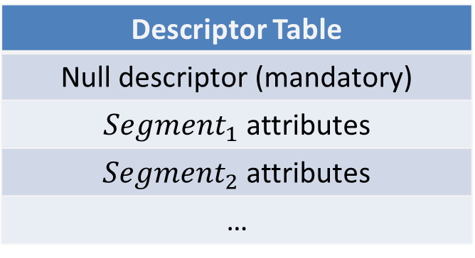
Protected mode
Segmentation details
Descriptor Table
Null descriptor (mandatory)
${Segment}_{1}$ attributes
${Segment}_{2}$ attributes
…
Segment Selector
Segment start address
Offset
+
Linear Address

Slide 15
Protected mode
(4-level) paging details
Linear Address
table 0 index | table 1 index | table 2 index | table 3 index | 4KiB page offset
next table address
next table address
next table address
…
next table address
level 0 table
next table address
next table address
next table address
…
next table address
level 1 table
next table address
next table address
next table address
…
next table address
level 2 table
4KiB page base address
4KiB page base address
4KiB page base address
…
4KiB page base address
level 3 table
+
Physical
address
CR3

Slide 16
Protected mode
Protection setup
  Control registers: dedicated 32-bit registers control and configuration
    CR0: bit 0 = Protection Enable (PE), bit 31 = Paging Enable (PG)
    CR2: after a page-fault exception it’s set to the faulting linear address
    CR3: contains the physical address of the data structures that define the precise mappings/translations performed through the paging mechanism, when active
    CR4: bit 5 = Physical Address Extension (PAE) – when set, it allows the paging function to translate the 32-bit input virtual addresses to 36 bits physical addresses (increasing the addressable physical memory from 4 GiB to a total of 64 GiB!)
  Dedicated instructions
    LGDT/SGDT [mem]: load/store the GDT (Global Descriptor Table) containing segment descriptors describing what segments should be available and their properties
      The operand is a data structure specifying a limit (size - 1) and a base for the actual table/array that contains the descriptors
      Each table descriptor is a QWORD packing all the segment attributes, bit by bit
    LIDT/SIDT [mem]: load/store the IDT (Interrupt Descriptor Table) containing interrupt descriptor entries describing how should exceptions, software and external interrupts be handled
      Similar to the LGDT/SGDT, the operand tells where and how large the table is
      Maximum of 256 entries, first 32 are predefined exception entries, the others can be used for external interrupts or software exceptions at OS discretion

Slide 17
Protected mode
Protection setup
  Sample code: real-mode to protected-mode transition and 32-bit segments
; the CPU is supposed to be in real-mode at the beginning of this code
bits 16
cli ; block maskable interrupts, their handlers don’t expect an altered CPU behavior!
mov eax, cr0 ; even though eax and cr0 are 32-bit wide, they’re available even in 16-bit code
or eax, 1 ; eax = CR0 with the LSB (bit 0 = Protection Enable) forced to 1
mov cr0, eax ; we’re now in protected-mode, CPL is 0 (ring 0) but still executing 16-bits code
; until cs is loaded with a value selecting a 32-bit code segment inside the GDT
lgdt [table_info] ; load a global descriptor table describing some memory segments
jmp 16 : start32 ; CS <- 16, IP <- start32, assumes new segment base = old base = 0
; the selected descriptor is found at byte index 16 inside the GDT
bits 32 ; the code at start32 will already be executed in 32 bits, ring 0!
; note: DS/SS/… still reference 64KiB segments until set to 8 (.data32)!
start32:
; ... 32-bit code ...
table_info:
.limit dw 3 * 8 - 1 ; we’re defining three segments (descriptors of 8 bytes each)
.base dd GDT ; and this is where the actual table can be found
GDT:
.null dq 0 ; this is a null descriptor loaded into unused seg. regs.
.data32 dq 0x00cf92000000ffff ; a 32-bit DPL=0 data segment of 4GiB starting at 0
.code32 dq 0x00cf9a000000ffff ; and a 32-bit ring=0 code segment of 4GiB starting at 0

